Slide 1
Chapter 2 Water: the Medium of Life

Slide 2
Outline
Properties of water
Osmotic Pressure
pH
Buffers, and how they work

Slide 3
2.1 What Are the Properties of Water?
Water has unusual properties:
High b.p., m.p., heat of vaporization, heat capacity, surface tension
Polar due to separation of centers of + and – charge
High dielectric constant
H-bond donor and acceptor
Potential to form four H-bonds per water molecule
Can ionize into H⁺ and OH⁻
Can accept and donate H⁺

Slide 4
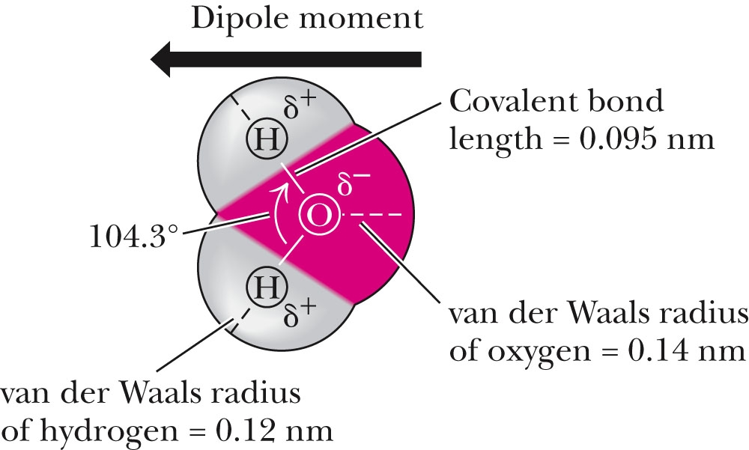
Fig. 2.1 The Structure of Water
Two lobes of negative charge formed by the lone-pair electrons of the oxygen atom lie above and below the plane of the diagram. This electron density contributes substantially to the large dipole moment. Note that the H—O—H angle is 104.3°, not 109°, the angular value found in molecules with tetrahedral symmetry, such as CH₄. (The dipole moment in this figure points in the direction from negative to positive, the convention used by physicists and physical chemists; organic chemists draw it pointing in the opposite direction.)

Slide 5
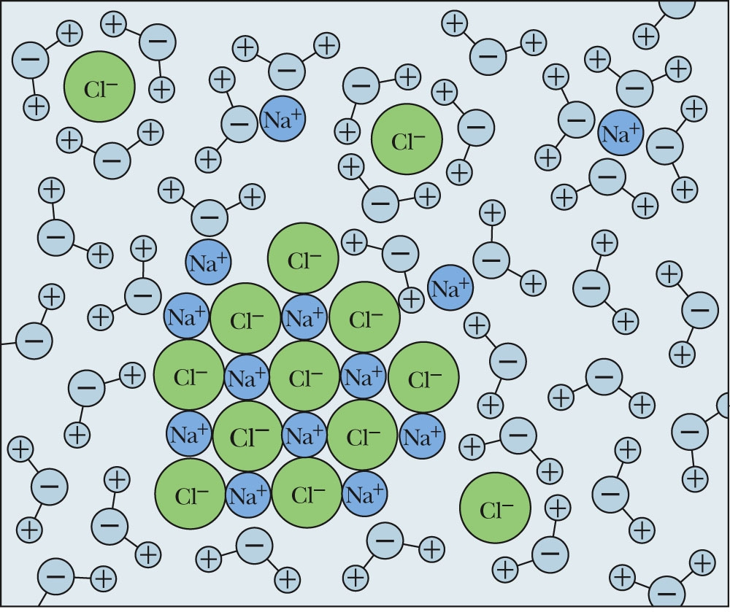
The Solvent Properties of Water Derive from Its Polar Nature
Figure 2.4 Hydration shells surrounding ions in solution.

Slide 6
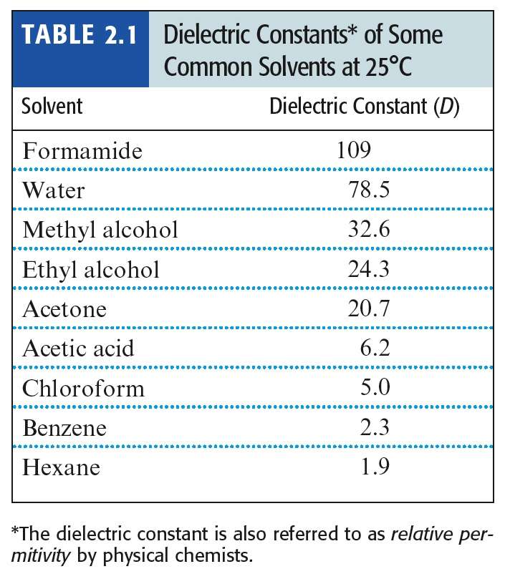
The Solvent Properties of Water Derive from Its Polar Nature
Notes:
http://skullsinthestars.com/2011/05/27/water-has-properties-that-are-positively-electrifying/
Phys Rev Lett. 2007 Jun 15;98(24):247401. Epub 2007 Jun 13.
Dipolar correlations and the dielectric permittivity of water.
Sharma M, Resta R, Car R.
Author information
Abstract
The static dielectric properties of liquid and solid water are investigated within linear response theory in the context of ab initio molecular dynamics. Using maximally localized Wannier functions to treat the macroscopic polarization we formulate a first-principles, parameter-free, generalization of Kirkwood's phenomenological theory. Our calculated static permittivity is in good agreement with experiment. Two effects of the hydrogen bonds, i.e., a significant increase of the average local moment and a local alignment of the molecular dipoles, contribute in almost equal measure to the unusually large dielectric constant of water.

Slide 7
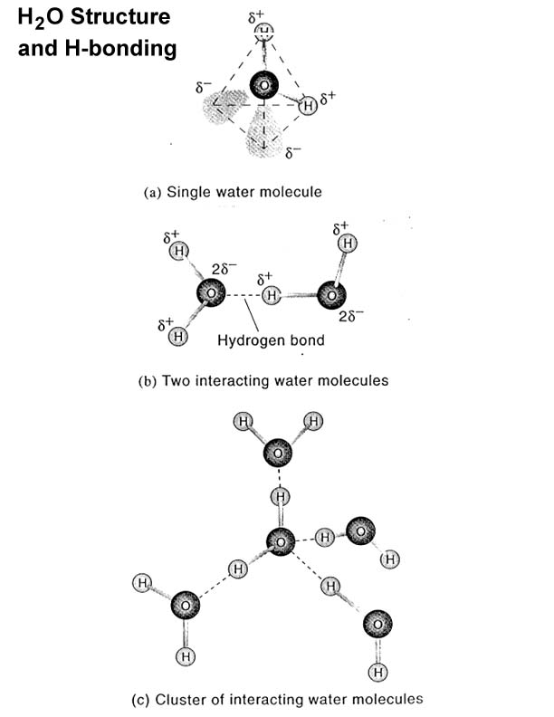

Slide 8
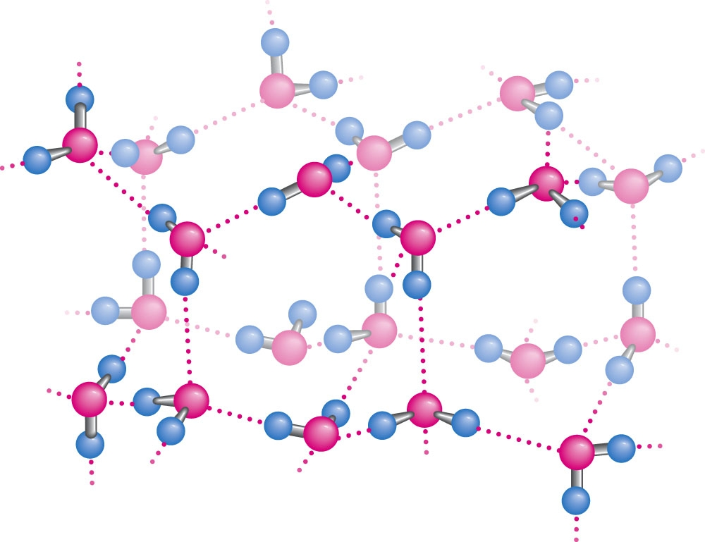
Figure 2.2 The structure of normal ice.
The hydrogen bonds in ice form a three-dimensional network. The smallest number of H₂O molecules in any closed circuit of H-bonded molecules is six, so this structure bears the name hexagonal ice. Covalent bonds are represented as solid lines, whereas hydrogen bonds are shown as dashed lines. The directional preference of H bonds leads to a rather open lattice structure for crystalline water and, consequently, a low density for the solid state. The distance between neighboring oxygen atoms linked by a hydrogen bond is 0.274nm. Since the covalent H-O bond is 0.095nm, the H-O hydrogen bond length in ice is 0.18 nm.

Slide 9
Comparison of Ice and Water
Issues: H-bonds and Motion
Ice: 4 H-bonds per water molecule
Water: 2.3 H-bonds per water molecule at 10ºC
Ice: H-bond lifetime - about 10 microsec
Water: H-bond lifetime - about 10 psec

Slide 10
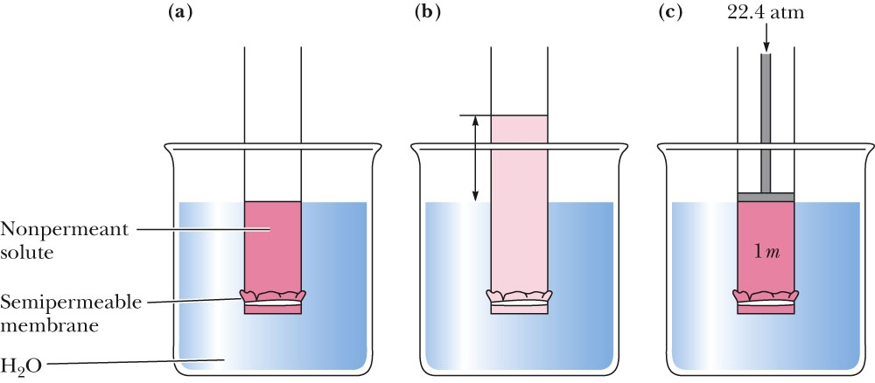
Important Colligative Property of Solutes: Osmotic Pressure
Figure 2.8 The osmotic pressure of a 1 molal (m) solution is equal to 22.4 atmospheres. Osmotic pressure is directly proportional to the concentration of the nonpermeant solute.

Slide 11
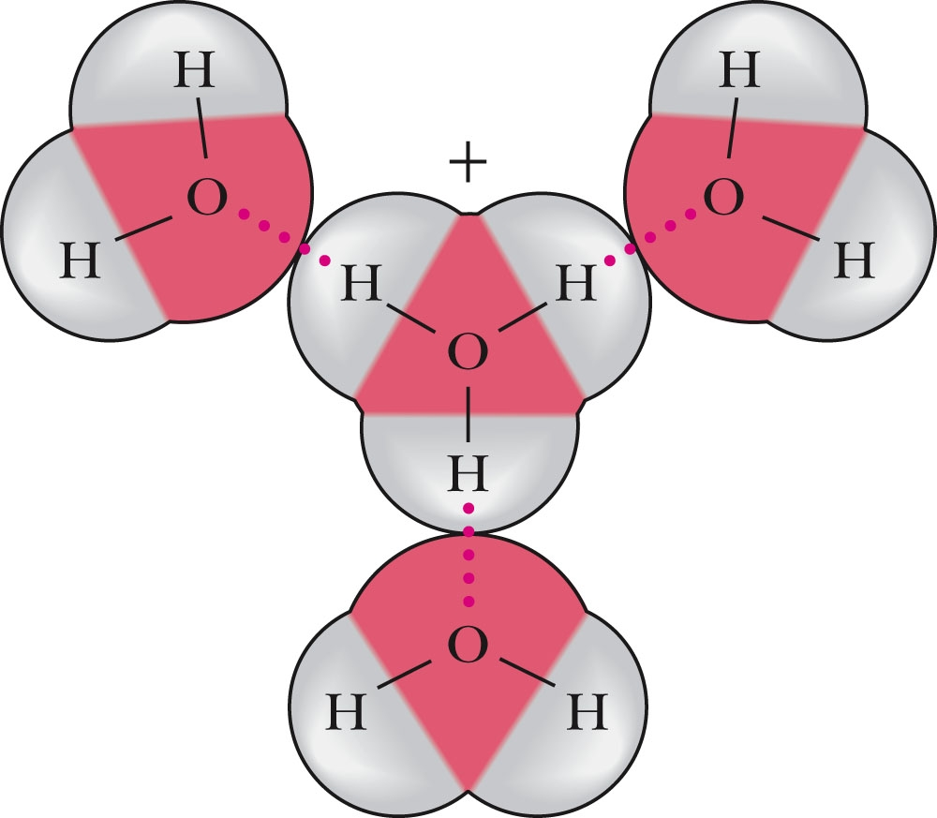
Water Can Ionize to Form H⁺ and OH⁻
Figure 2.10 The hydration of H₃O⁺.

Slide 12
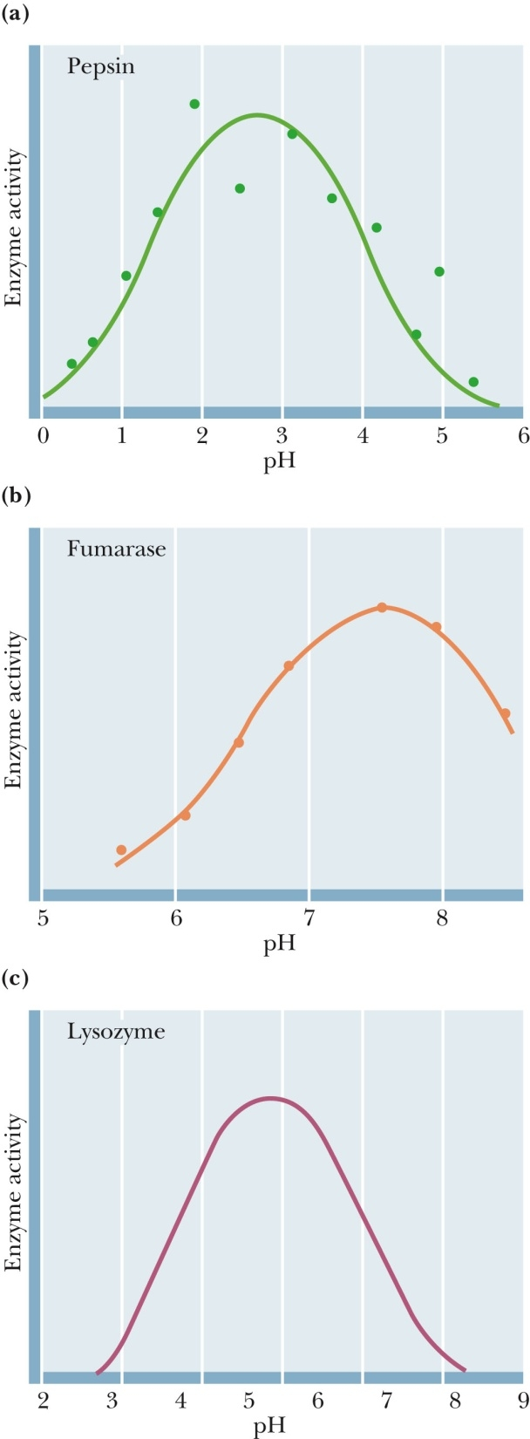
2.2 Enzyme Activity is Influenced by pH
Figure 2.15 pH versus enzymatic activity.
Pepsin is a protein-digesting enzyme active in gastric fluid. Fumarase is a metabolic enzyme found in mitochondria.
Lysozyme digests the cell walls of bacteria. It is found in tears.

Slide 13
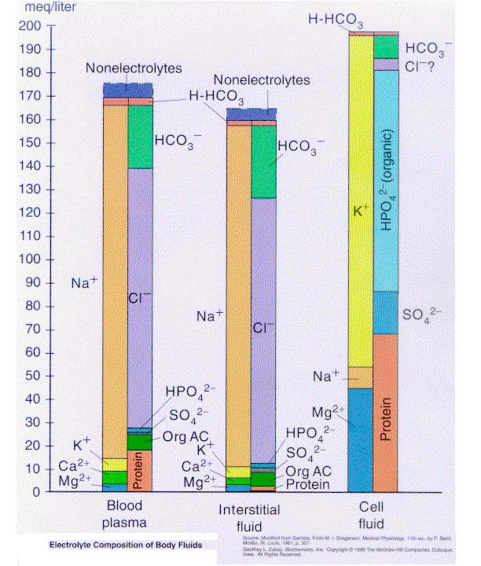
What are the pH Buffers of Life?

Slide 14
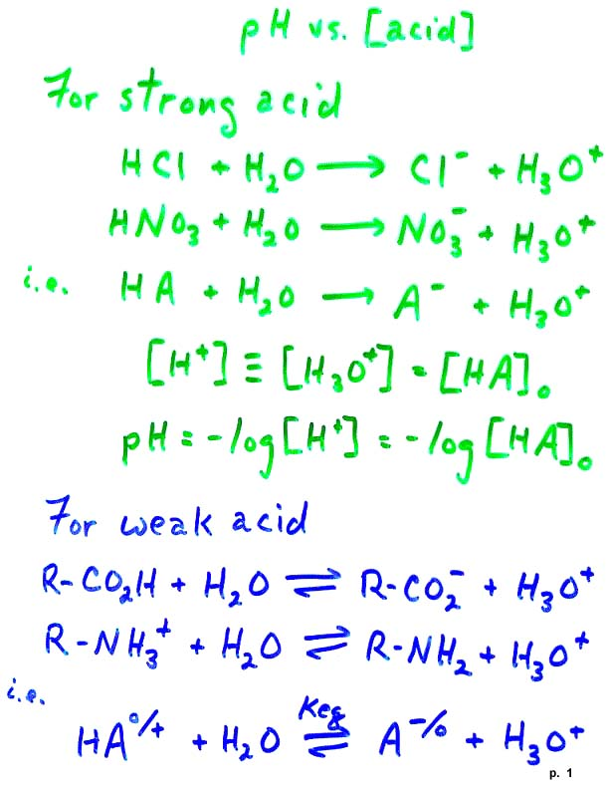
pH Equations

Slide 15
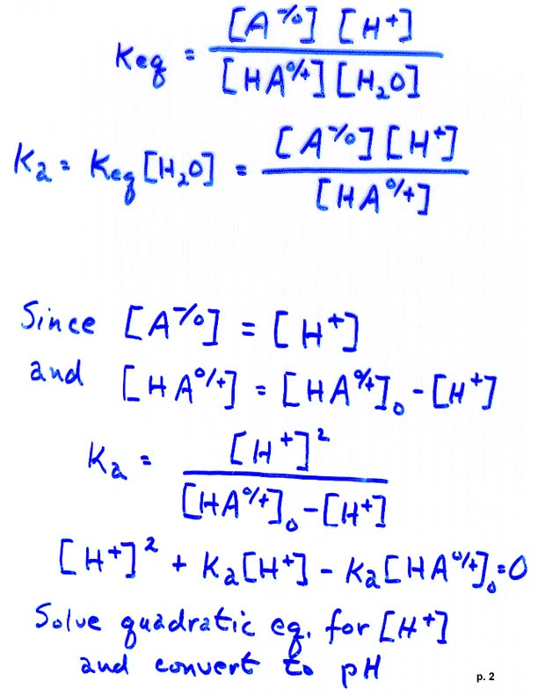

Slide 16
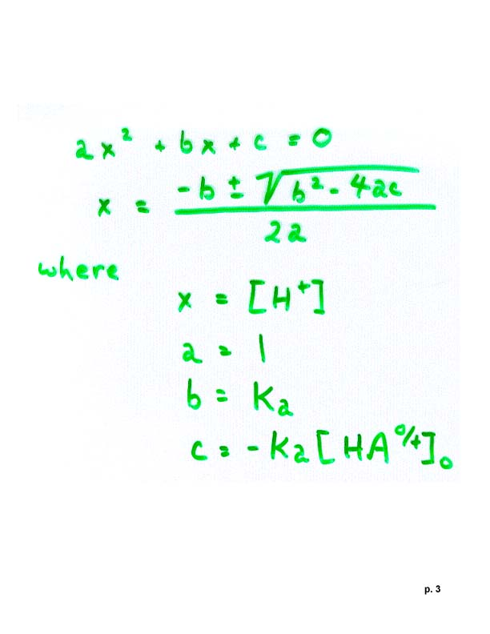

Slide 17
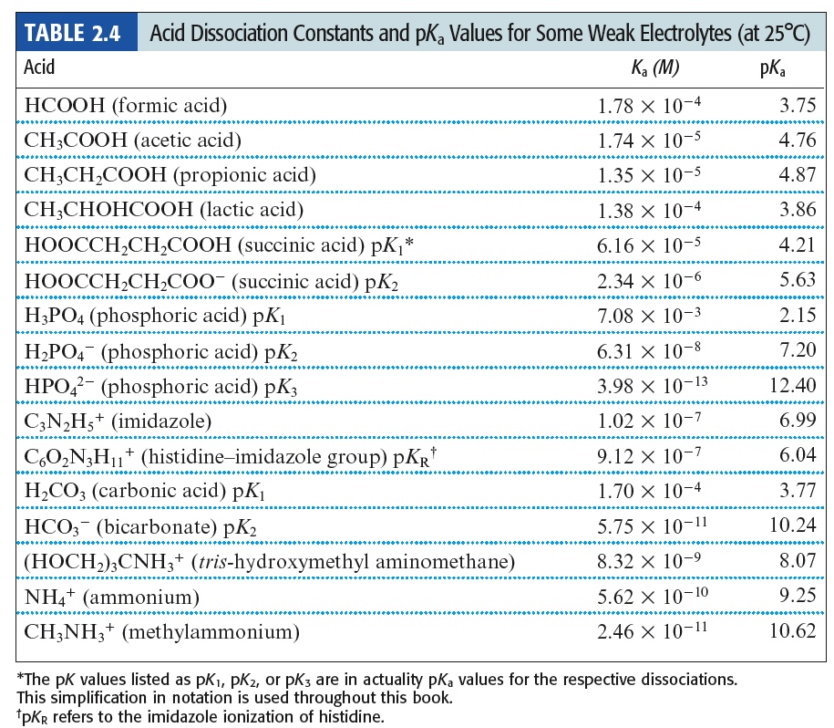

Slide 18
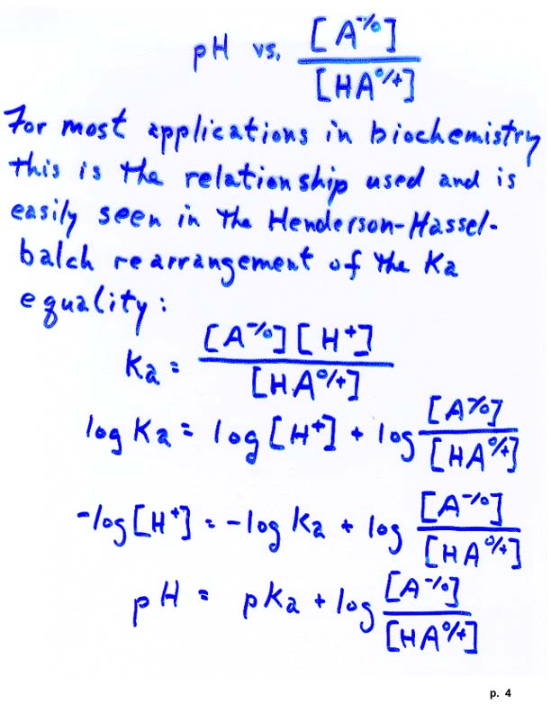

Slide 19
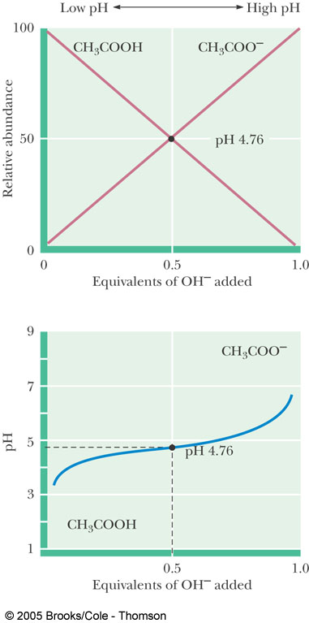
Figure 2.11 The titration curve for acetic acid. Note that the titration curve is relatively flat at pH values near the pK_{a}. In other words, the pH changes relatively little as OH⁻ is added in this region of the titration curve.

Slide 20
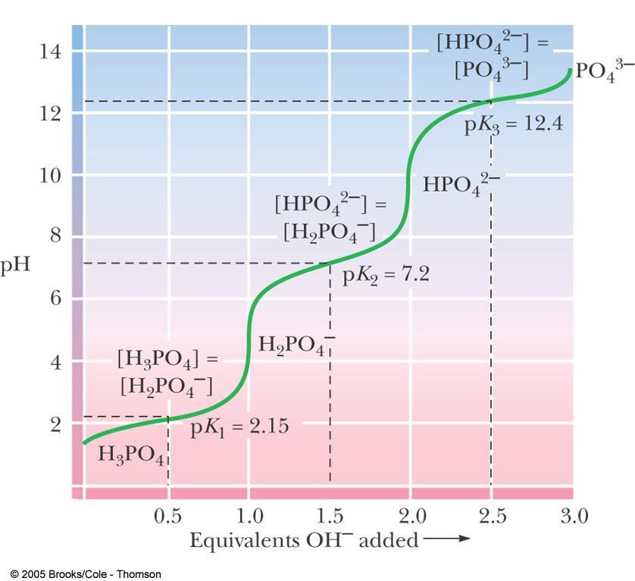
Figure 2.13 The titration curve for phosphoric acid. The chemical formulas show the prevailing ionic species present at various pH values. Phosphoric acid (H₃PO₄) has three titratable hydrogens and therefore three midpoints are seen: at pH 2.15 (pK₁), pH 7.20 (pK₂), and pH 12.4 (pK₃).

Slide 21
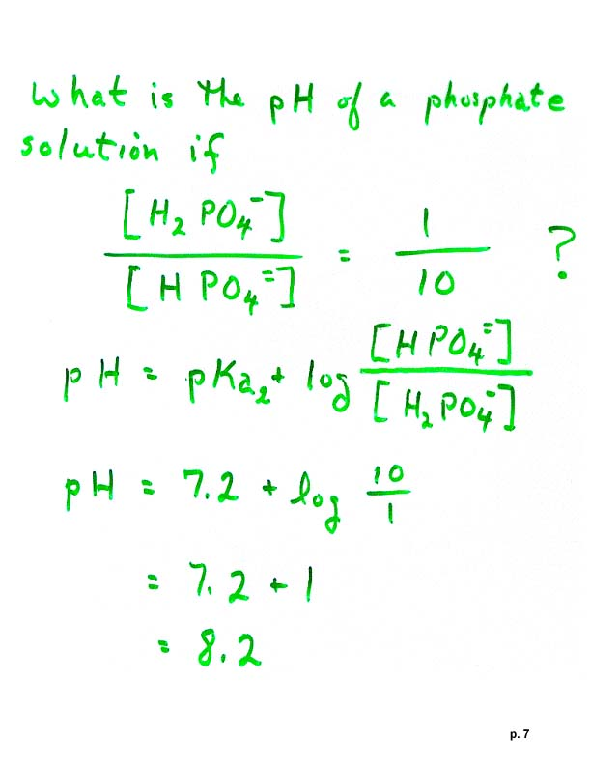

Slide 22
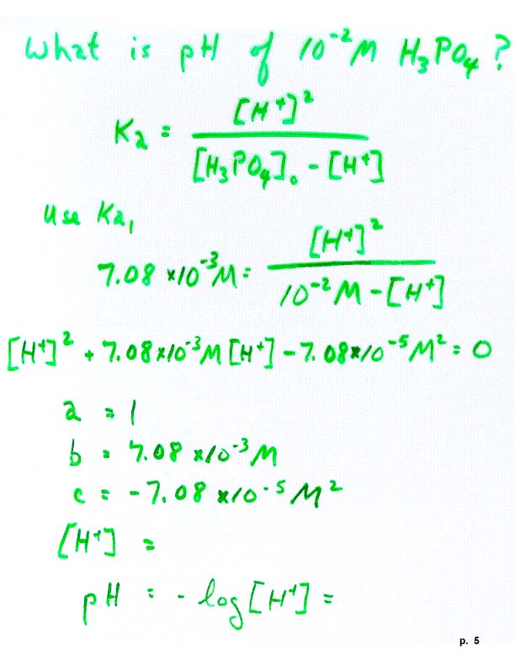

Slide 23
2.3 What Are Buffers, and What Do They Do?
Buffers are solutions that resist changes in pH as acid and base are added.
Most buffers consist of a weak acid and its conjugate base.
Buffer range is pKa ± 1.0. This is the range in which a buffer can be used reliably.

Slide 24
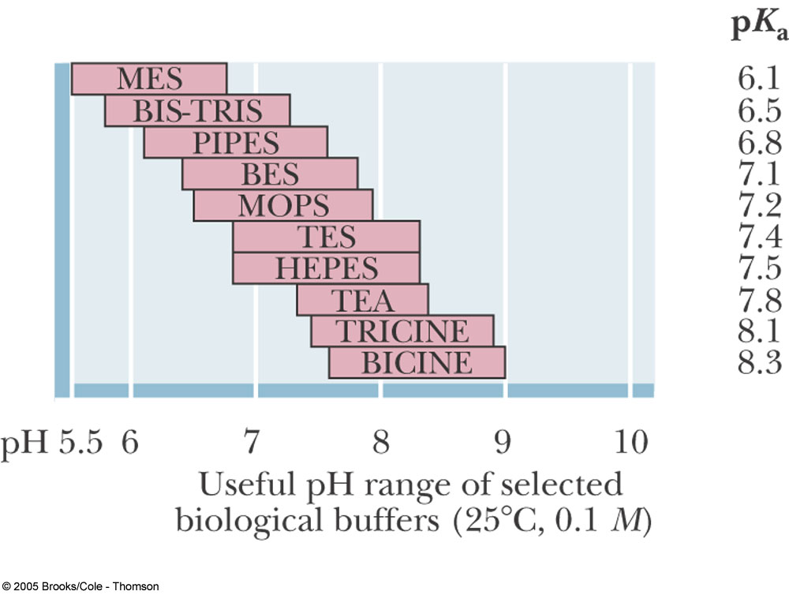
What are Buffers and What Do They Do?

Slide 25
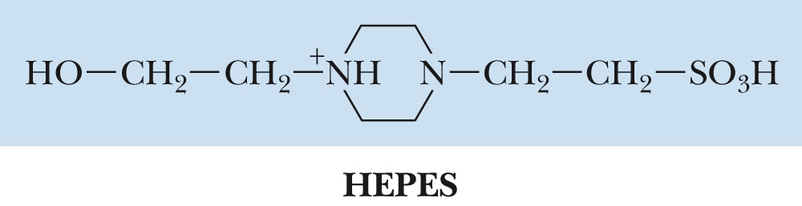
What are Buffers and What Do They Do?
Figure 2.17 The structure of HEPES, in its fully protonated form.
Notes:
HEPES is a sulfonic acid.

Slide 26
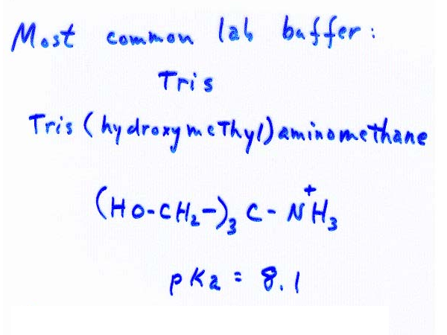
Most Common Biochemistry Lab Buffer
Tris (hydroxymethyl)aminomethane

Slide 28
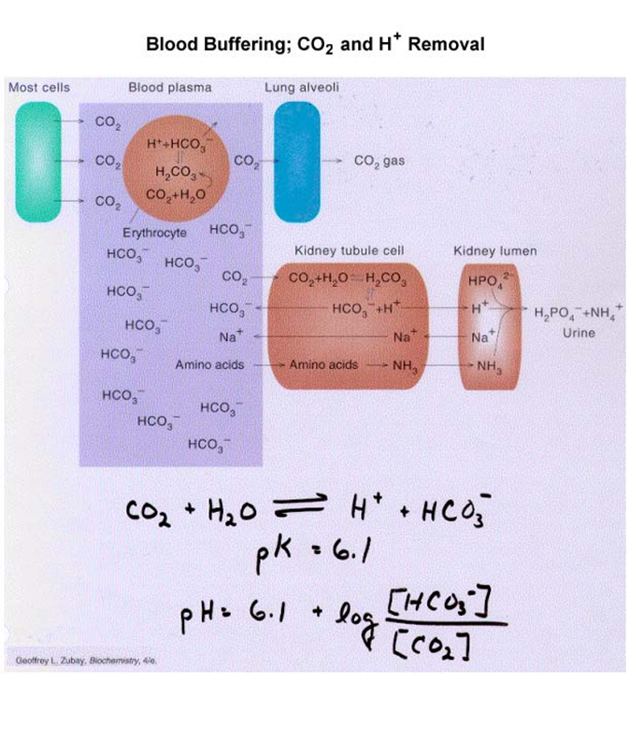

Slide 29
NB: If you are using the G&G 4th ed.,
in the text box ‘The Bicarbonate Buffer System of Blood Plasma’ on p.43, middle of right column, there is a typo.
The overall equilibrium for the ionization of H₂CO₃ in equilibrium with CO₂(d) should be
KaKh = [H⁺][HCO₃⁻]/[CO₂(d)
i.e., Kh sould not be present on the right side of the equation

